Slide 1


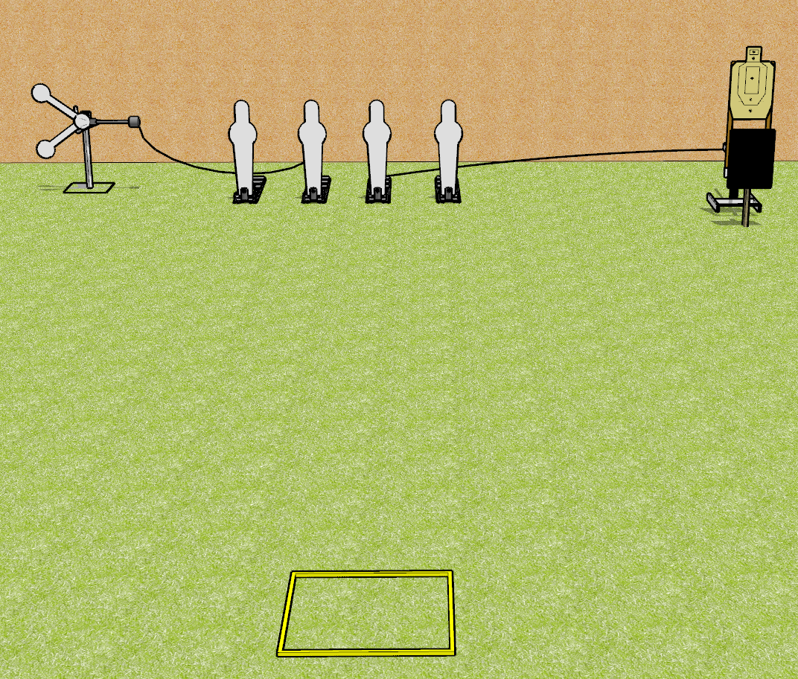
 | Dothan Gun Club – USPSA Match Don’t Ping too Much Course Designer : Drew Coleman
START POSITION : Standing in shooting box, wrists below belt
GUN READY CONDITION : Pistol loaded and holstered. PCC loaded, buttstock on belt, safety on |  | SCORING: Comstock, 8 rounds TARGETS: 1 paper, 6 Steel SCORED HITS: Best 2 on paper, steel until down START-STOP: Audible, last shot RULES:
STAGE PROCEDURE: Engage targets as they become available from within the fault lines.

Slide 2
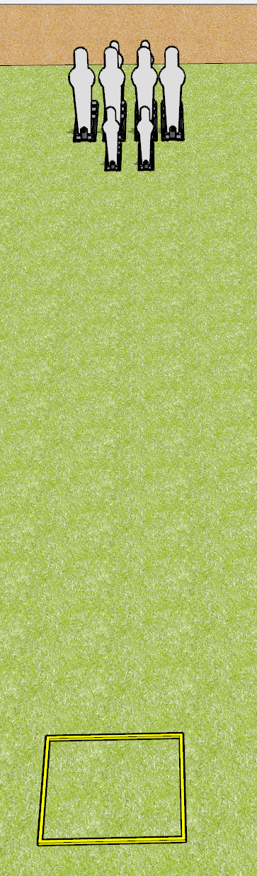
 | Dothan Gun Club – USPSA Match Short and Tall Course Designer : Drew Coleman
START POSITION : Standing facing uprange in shooting box, wrists below belt
GUN READY CONDITION : Pistol loaded and holstered. PCC loaded, buttstock on belt, safety on, pointed down range. |  | SCORING: Comstock, 8 rounds TARGETS: 0 paper, 8 Steel SCORED HITS: Best 2 on paper, steel until down START-STOP: Audible, last shot RULES:
STAGE PROCEDURE: Engage targets as they become available from within the fault lines.

Slide 3
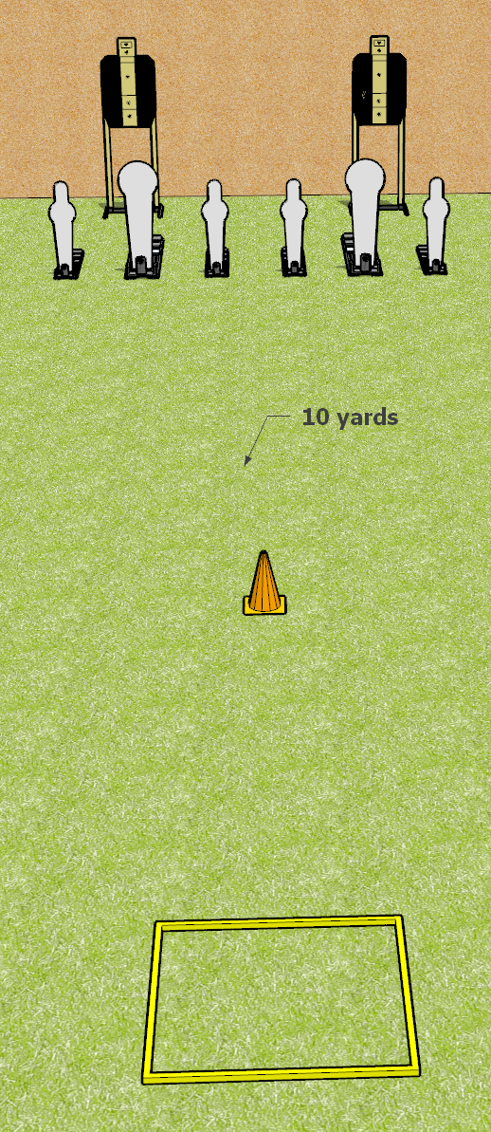
 | Dothan Gun Club – USPSA Match My One Weakness Course Designer : Drew Coleman
START POSITION : Standing in the shooting box. Wrists below belt.
GUN READY CONDITION : Pistol loaded and holstered. PCC loaded, shouldered, safety on, pointed at orange cone. |  | SCORING: Comstock, 12 rounds TARGETS: 2 paper, 6 Steel SCORED HITS: Best 3 on paper, steel until down START-STOP: Audible, last shot RULES: failure to perform a mandatory reload before changing arrays is a procedural per shot fired. Failure to engage 2nd array weak hand only is a procedural per shot fired
STAGE PROCEDURE: Engage the poppers or the paper targets, perform a mandatory reload and then engage the other array weak hand only

Slide 4
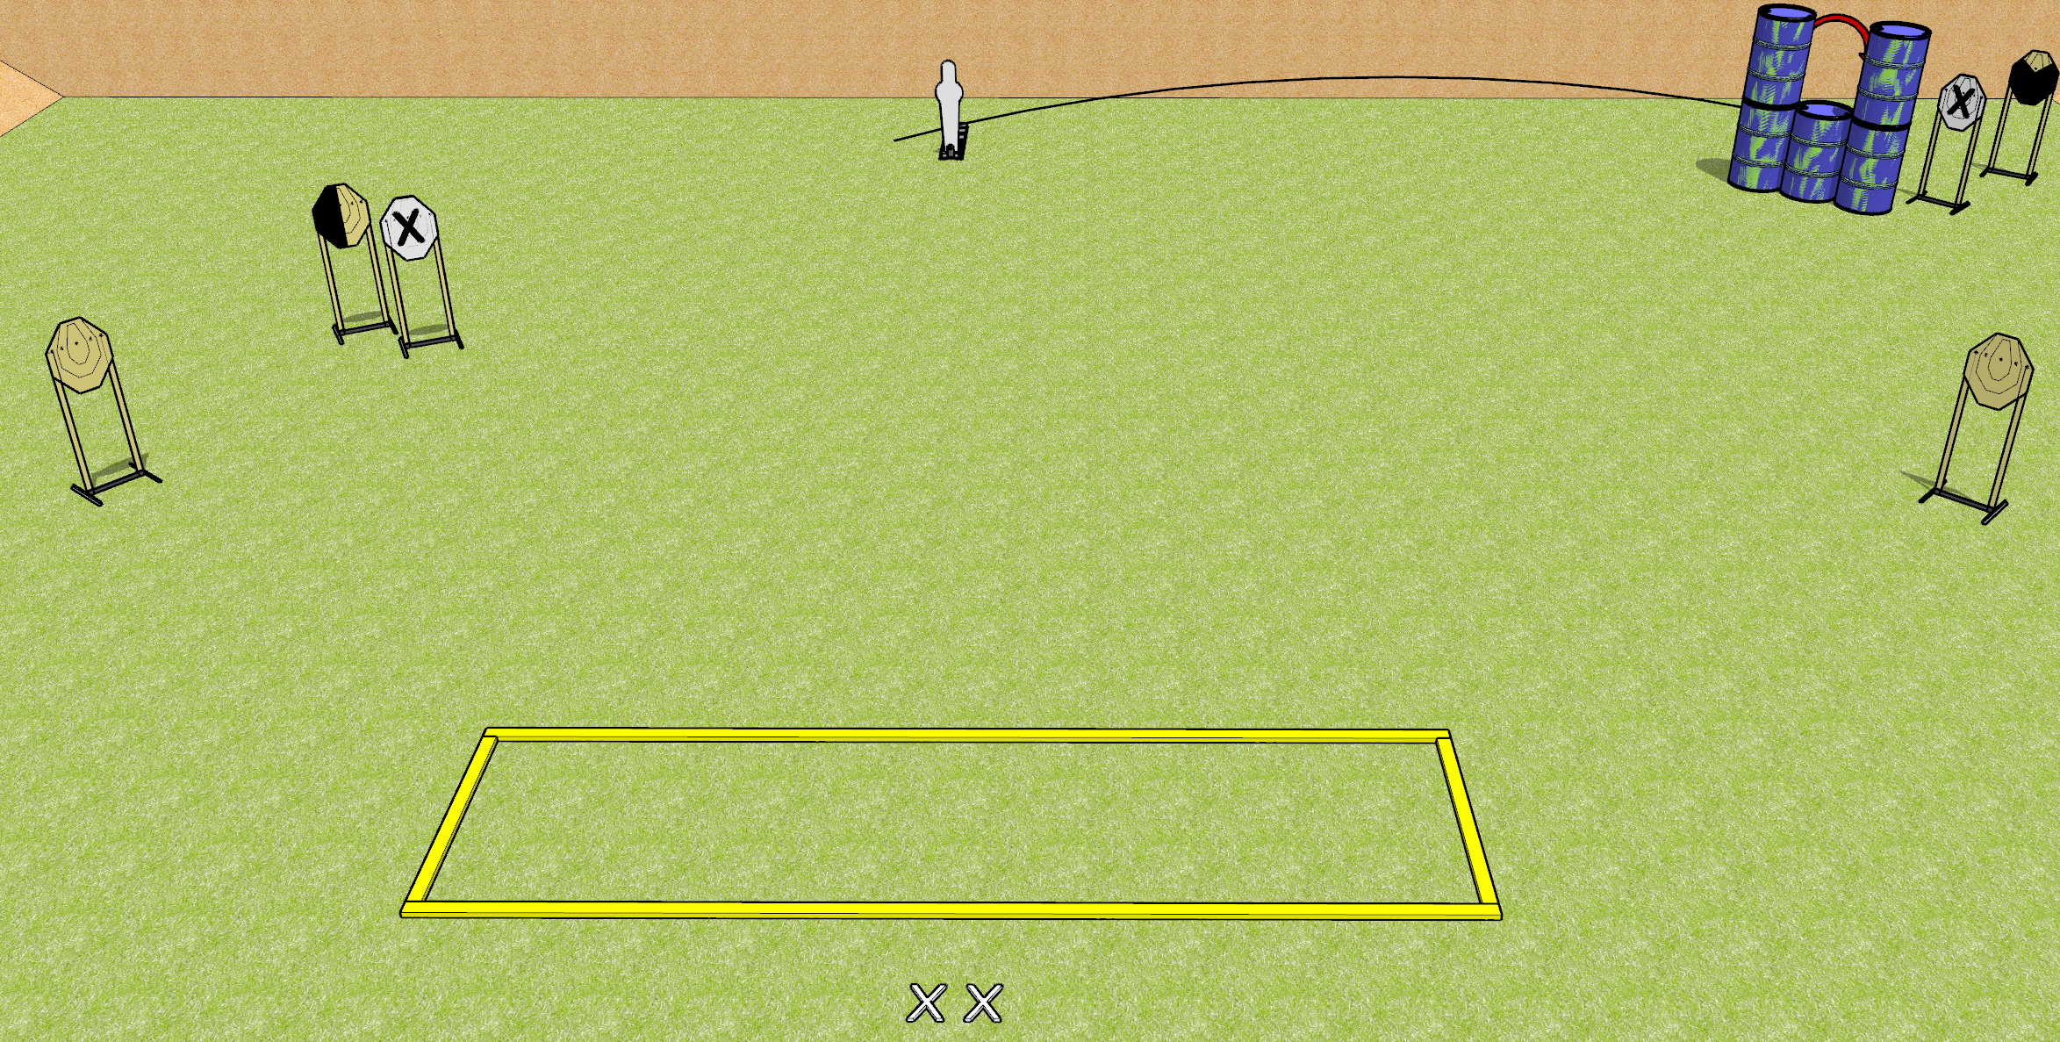
 | Dothan Gun Club – USPSA Match Now You See Me Course Designer : Drew Coleman
START POSITION : Standing with both feet on X’s, wrists below belt
GUN READY CONDITION : Pistol loaded and holstered. PCC loaded, shouldered, safety on, pointed at orange cone. |  | SCORING: Comstock, 11 rounds TARGETS: 5 paper, 1 Steel SCORED HITS: Best 2 on paper, steel until down START-STOP: Audible, last shot RULES:
STAGE PROCEDURE: Engage targets as they become available from within the fault lines.

Slide 5
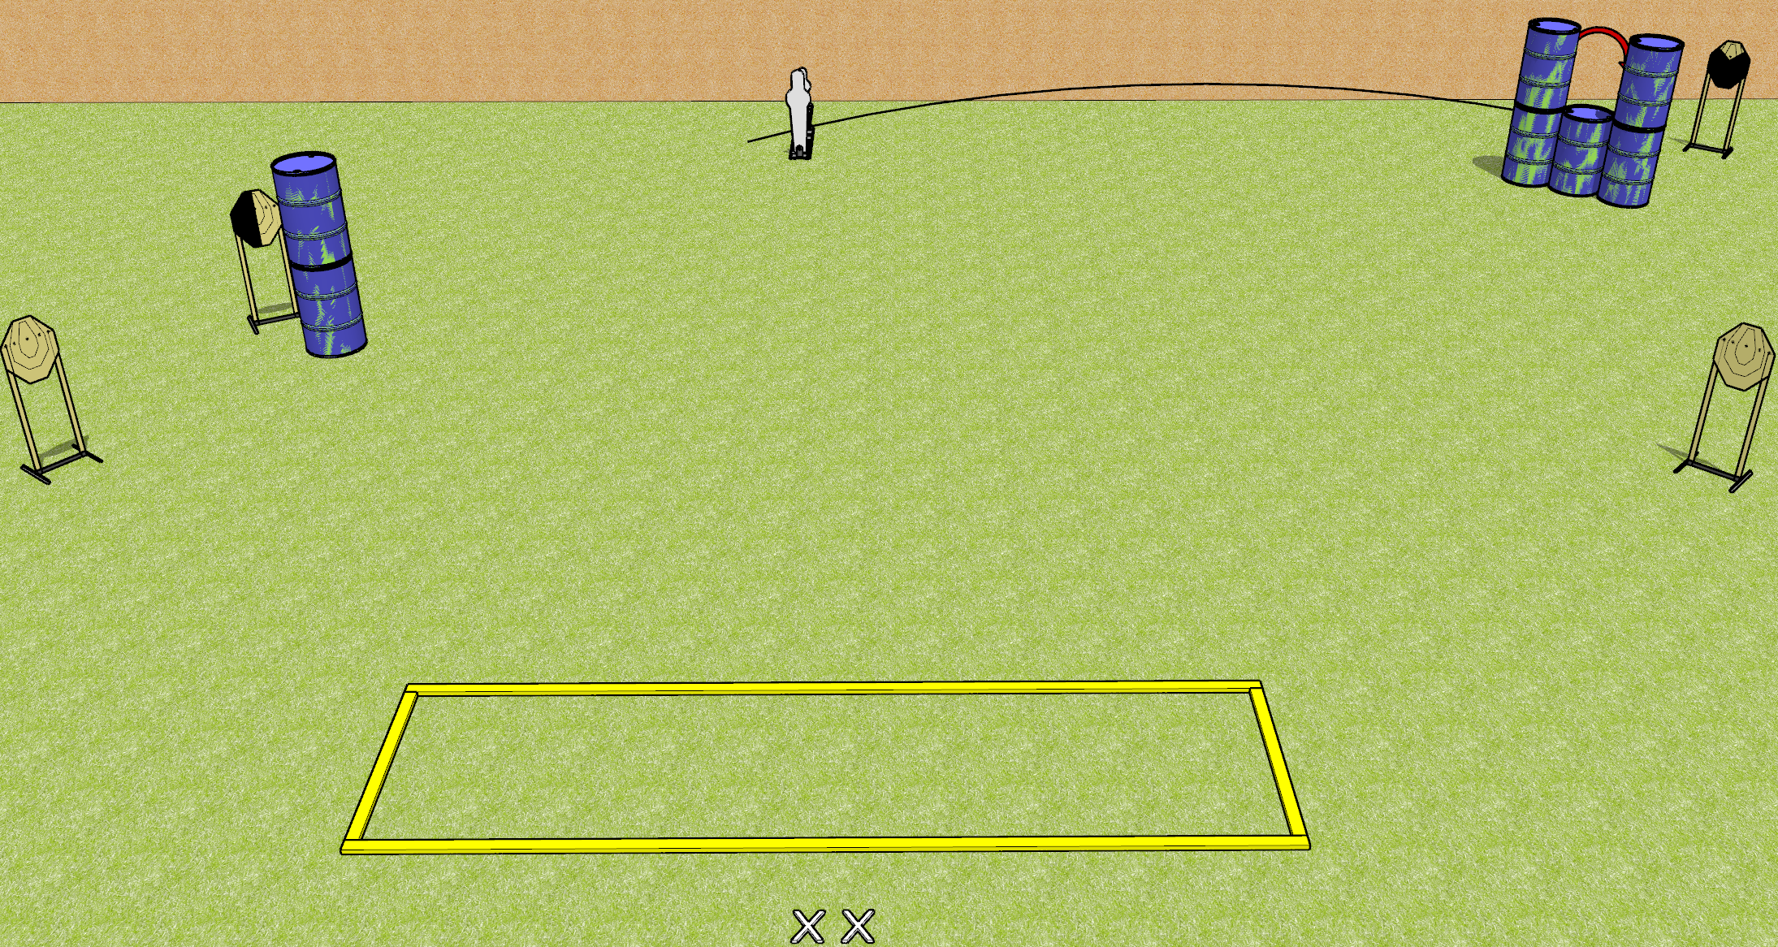
 | Dothan Gun Club – USPSA Match Get to Stepping Course Designer : Drew Coleman
START POSITION : Standing with both feet on X’s, wrists below belt
GUN READY CONDITION : Pistol loaded and holstered. PCC loaded, shouldered, safety on, pointed at orange cone. |  | SCORING: Comstock, 12 rounds TARGETS: 5 paper, 2 Steel SCORED HITS: Best 2 on paper, steel until down START-STOP: Audible, last shot RULES:
STAGE PROCEDURE: Engage targets as they become available from within the fault lines.
Mini popper behind pepper popper

Slide 6
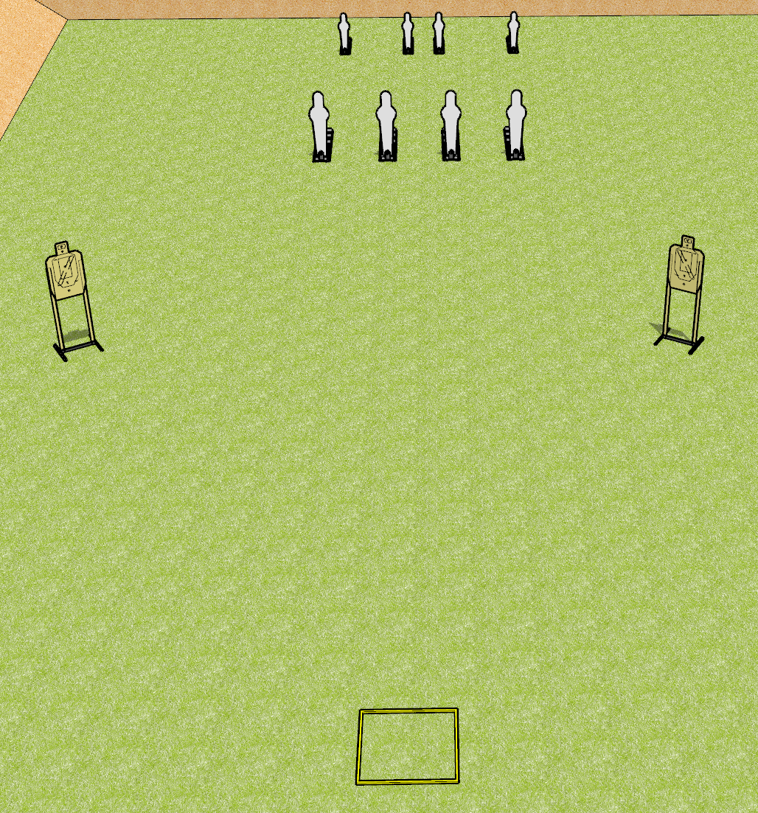
 | Dothan Gun Club – USPSA Match A Stage Has No Name Course Designer : Drew Coleman
START POSITION : Standing in the shooting box, facing uprange. Hands relaxed at sides.
GUN READY CONDITION : Pistol loaded and holstered. PCC buttstock on belt, pointed at back berm. |  | SCORING: Comstock, 16 rounds TARGETS: 2 paper, 8 Steel SCORED HITS: Best 4 on paper, steel until down START-STOP: Audible, last shot RULES: failure to perform a mandatory reload before switching arrays will be a procedural penalty per shot fired.
STAGE PROCEDURE: Engage the steel OR the paper targets from within the shooting box, perform a mandatory reload, and engage the remaining array weak hand only

Slide 7
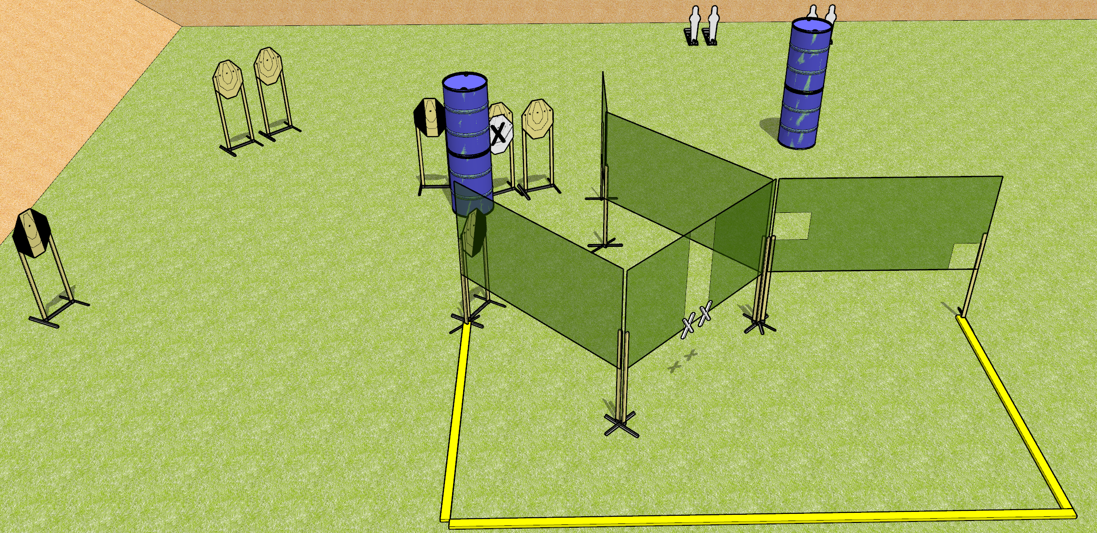
 | Dothan Gun Club – USPSA Match Punch Buggy Course Designer : Drew Coleman
START POSITION : Standing with both hands touching marks. PCC muzzle touching right hand mark.
GUN READY CONDITION : Pistol loaded and holstered. PCC loaded, shouldered, safety on. |  | SCORING: Comstock, 20 rounds TARGETS: 8 paper, 4 Steel SCORED HITS: Best 2 on paper, steel until down START-STOP: Audible, last shot RULES:
STAGE PROCEDURE: Engage targets as they become available from within the fault lines.

Slide 8
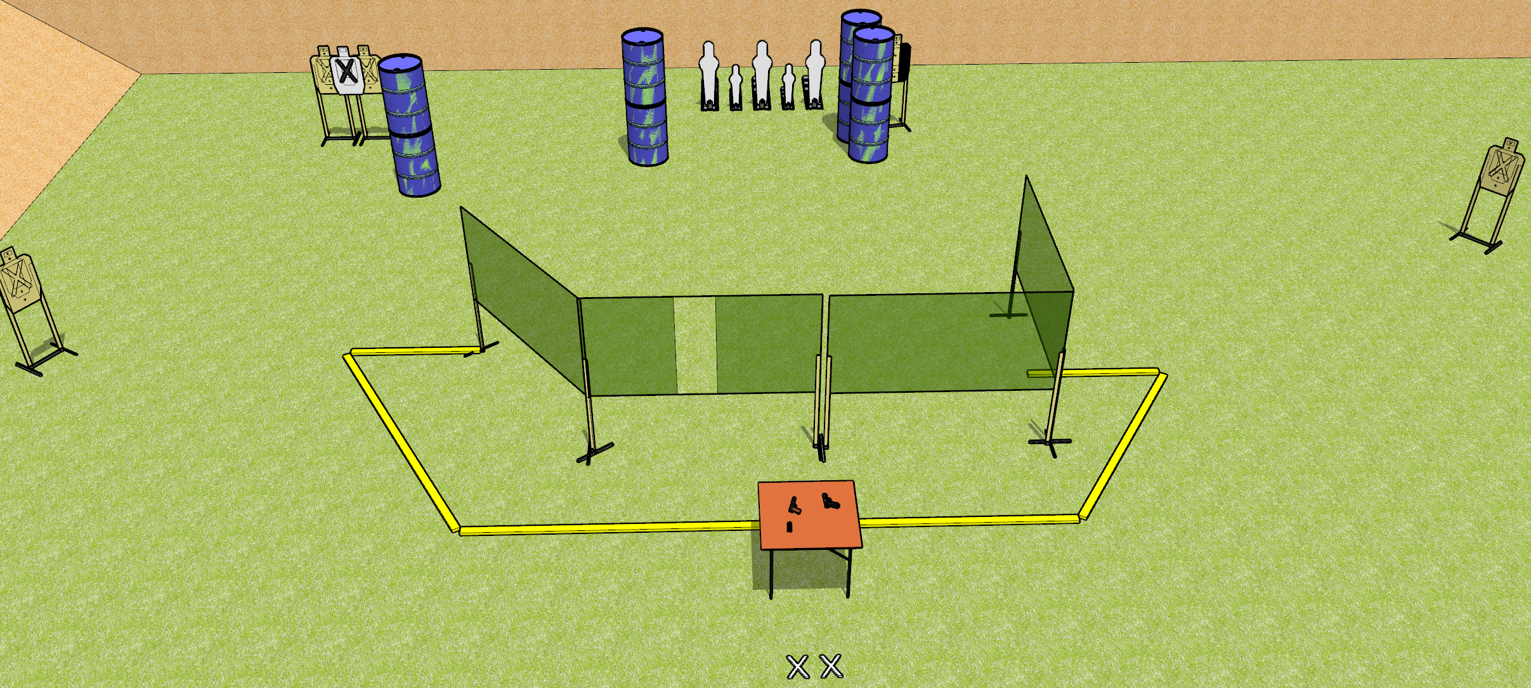
 | Dothan Gun Club – USPSA Match Triple Tap Course Designer : Drew Coleman
START POSITION : Standing with both feet on X’s, wrists below belt
GUN READY CONDITION : Pistol/PCC unloaded on table, trigger guard on mark. Magazines on belt. |  | SCORING: Comstock, 20 rounds TARGETS: 5 paper, 5 Steel SCORED HITS: Best 3 on paper, steel until down START-STOP: Audible, last shot RULES: Pistol/PCC must be slide/cylinder/bolt closed, hammer down.
STAGE PROCEDURE: Engage targets as they become available from within the fault lines.

Slide 9
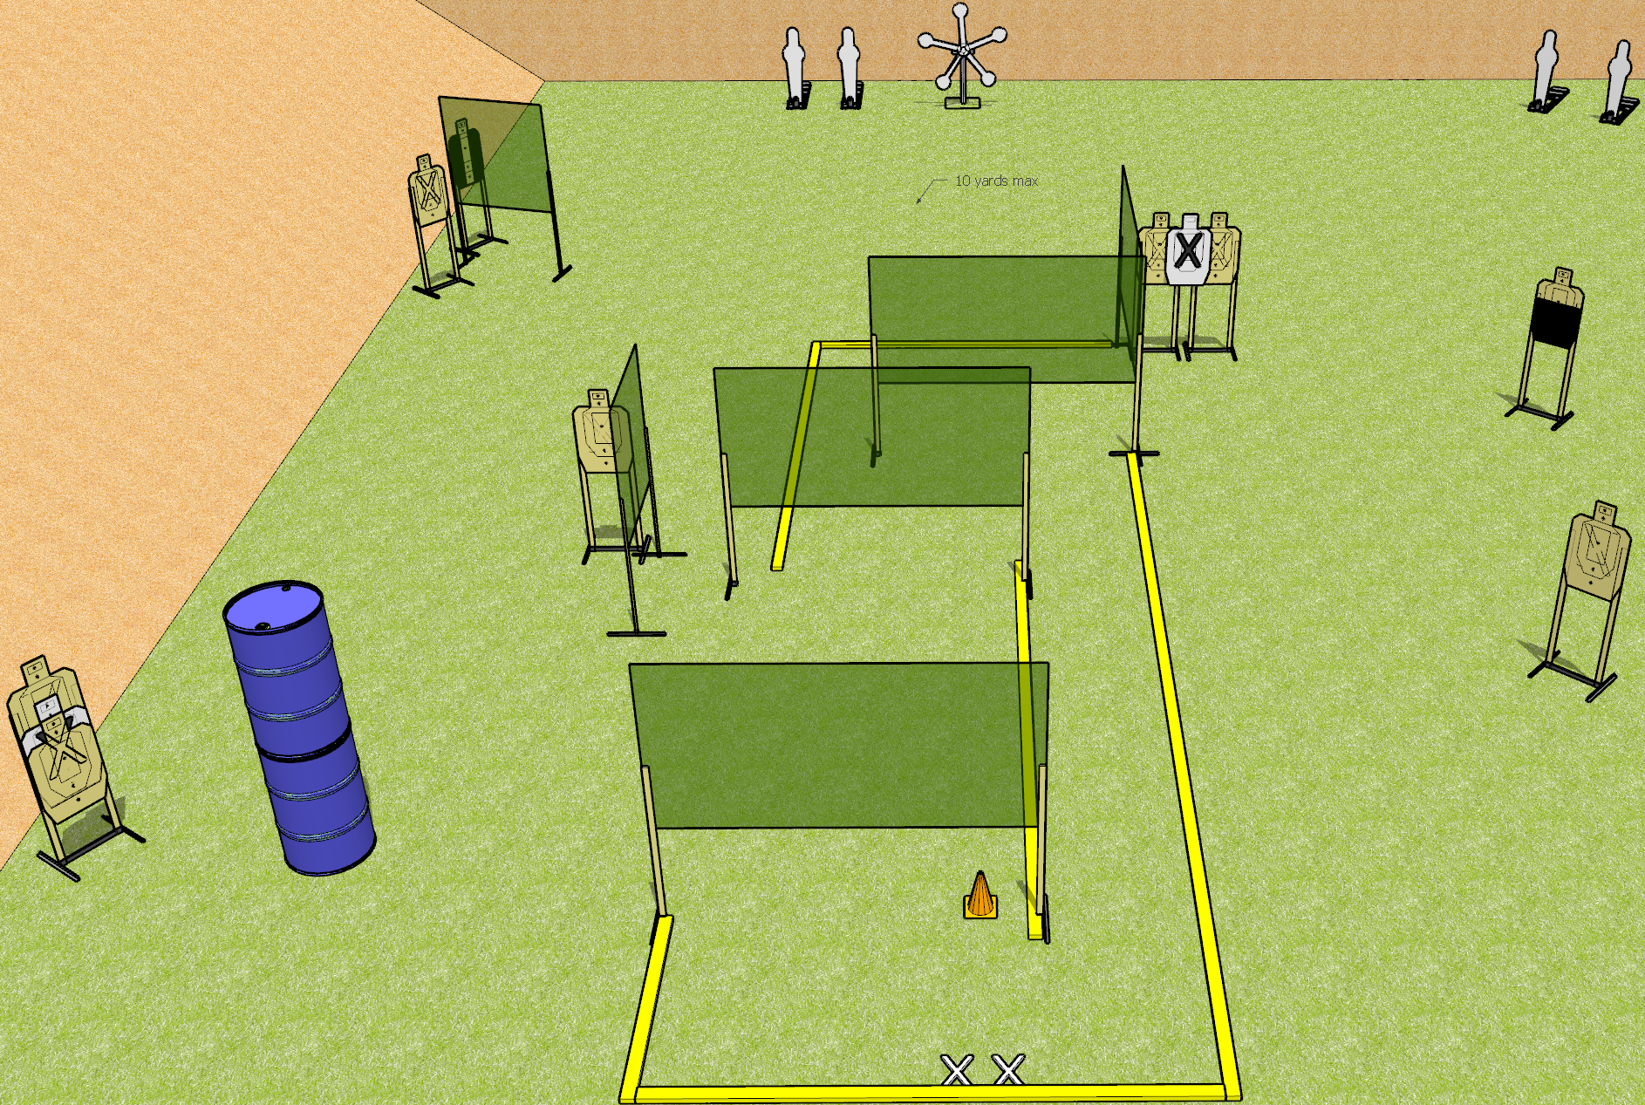
 | Dothan Gun Club – USPSA Match Leave my walls Alone Course Designer : Drew Coleman
START POSITION : Standing with both feet on X’s, wrists below belt
GUN READY CONDITION : Pistol loaded and holstered. PCC loaded, shouldered, safety on, pointed at orange cone. |  | SCORING: Comstock, 27 rounds TARGETS: 9 paper, 9 Steel SCORED HITS: Best 2 on paper, steel until down START-STOP: Audible, last shot RULES:
STAGE PROCEDURE: Engage targets as they become available from within the fault lines.

Slide 10
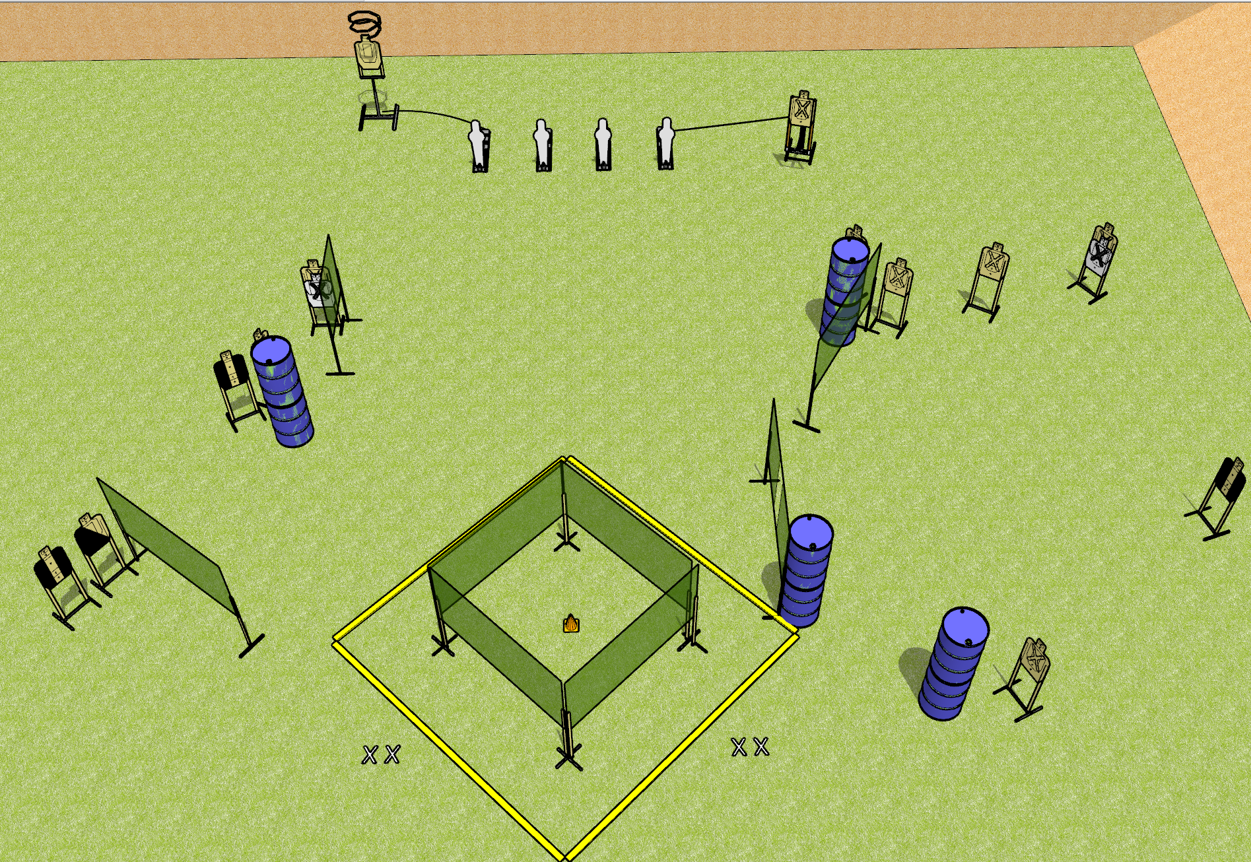
 | Dothan Gun Club – USPSA Match Circling the Drain Course Designer : Drew Coleman
START POSITION : Standing with both feet on X’s, wrists below belt
GUN READY CONDITION : Pistol loaded and holstered. PCC loaded, shouldered, safety on, pointed at orange cone. |  | SCORING: Comstock, 30 rounds TARGETS: 13 paper, 4 Steel SCORED HITS: Best 2 on paper, steel until down START-STOP: Audible, last shot RULES: Drop turner is disappearing
STAGE PROCEDURE: Engage targets as they become available from within the fault lines.

Slide 11
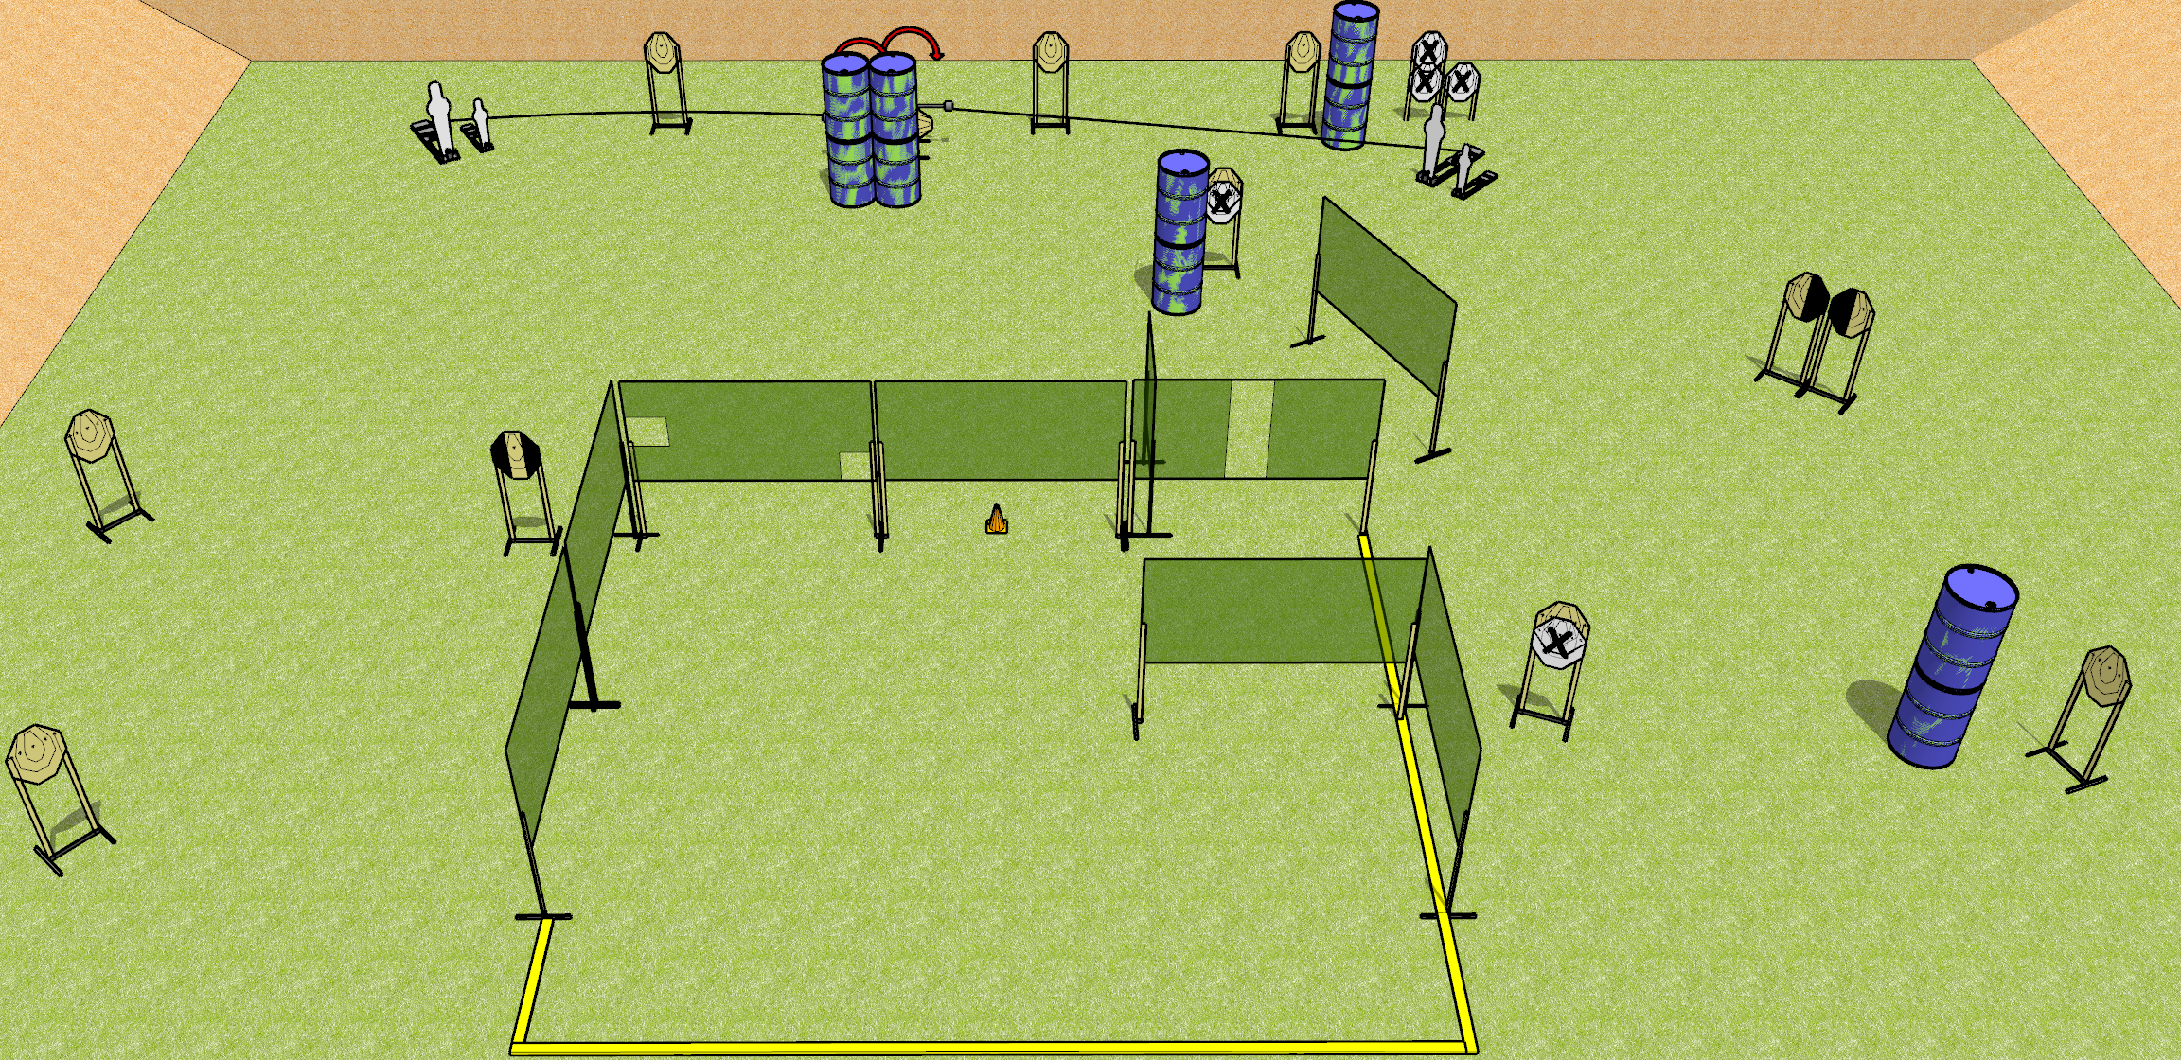
 | Dothan Gun Club – USPSA Match Swinging Together Course Designer : Drew Coleman
START POSITION : Standing anywhere along rear fault line outside the shooting area, toes touching rear fault line. Wrists below belt
GUN READY CONDITION : Pistol loaded and holstered. PCC loaded, shouldered, safety on, pointed at orange cone. |  | SCORING: Comstock, 30 rounds TARGETS: 13 paper, 4 Steel SCORED HITS: Best 2 on paper, steel until down START-STOP: Audible, last shot RULES:
STAGE PROCEDURE: Engage targets as they become available from within the fault lines.

Slide 12
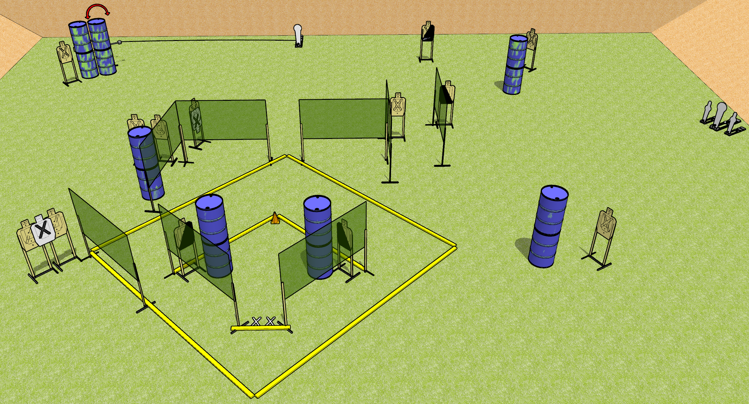
 | Dothan Gun Club – USPSA Match Grand Slam Course Designer : Drew Coleman
START POSITION : Standing with both feet on X’s, heels against fault line. Hands relaxed at sides.
GUN READY CONDITION : Pistol loaded and holstered. PCC loaded, shouldered, safety on, pointed at orange cone. |  | SCORING: Comstock, 32 rounds TARGETS: 14 paper, 4 Steel SCORED HITS: Best 2 on paper, steel until down START-STOP: Audible, last shot RULES: shooting Dan’s walls will incur a $25 fee per hit, payable in cash.
STAGE PROCEDURE: Engage targets as they become available from within the fault lines

Slide 13
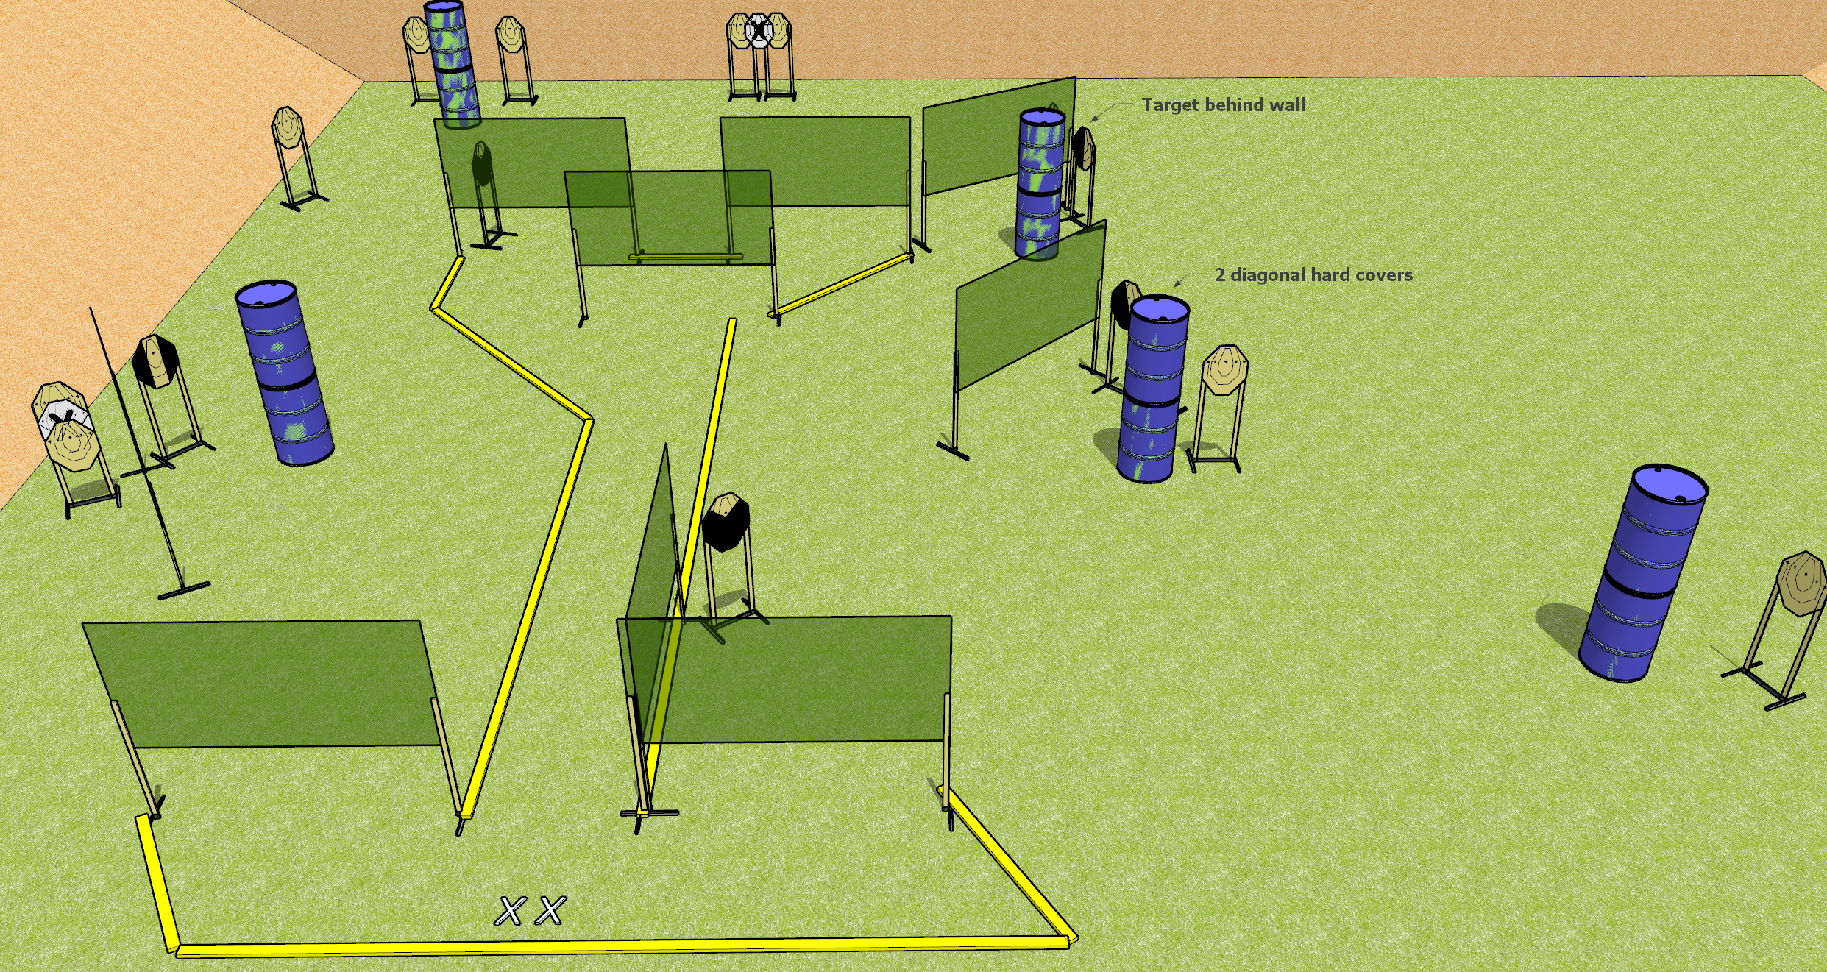
 | Dothan Gun Club – USPSA Match Whatcha Doin’? Course Designer : Drew Coleman
START POSITION : Standing with both feet on X’s, wrists below belt
GUN READY CONDITION : Pistol loaded and holstered. PCC loaded, buttstock on belt, safety on, pointed in a safe direction. |  | SCORING: Comstock, 34 rounds TARGETS: 17 paper, 0 Steel SCORED HITS: Best 2 on paper, steel until down START-STOP: Audible, last shot RULES:
STAGE PROCEDURE: Engage targets as they become available from within the fault lines.

